Slide 1
GeACT update Genomic Architecture of Cells in Tissues
11/3/2020
Notes:
大家好，今天我总结一下GeACT。

Slide 2
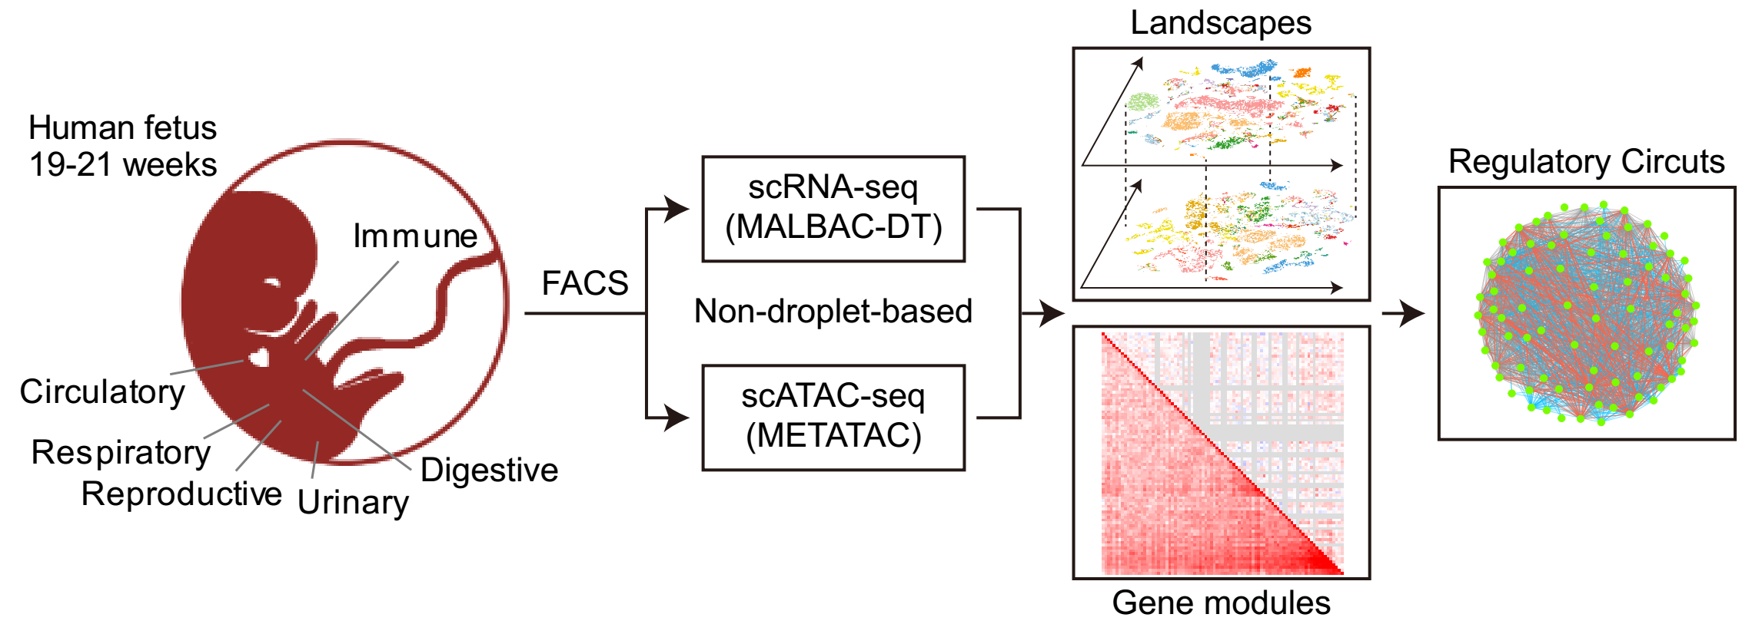
1. Overview
More data from 14-week-old samples.
RNA: 31,208 -> 37,269 cells (new data: stomach and small intestine)
ATAC: 21,381 -> ?
10-14 weeks

Slide 3
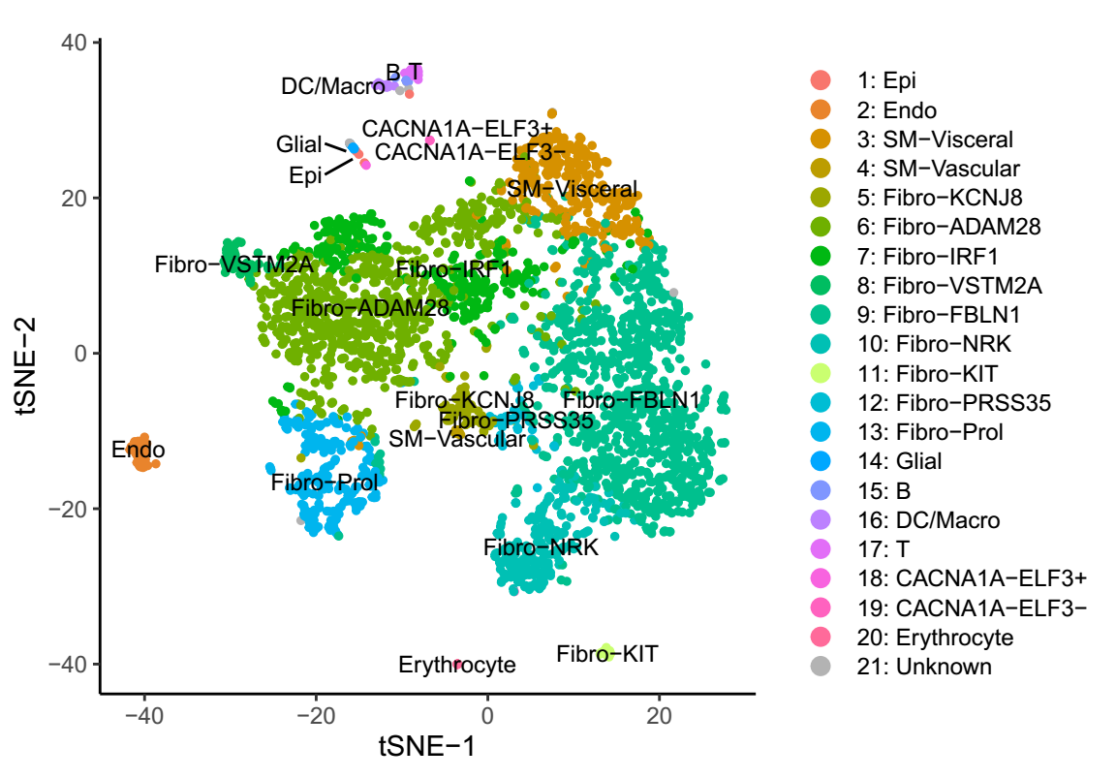
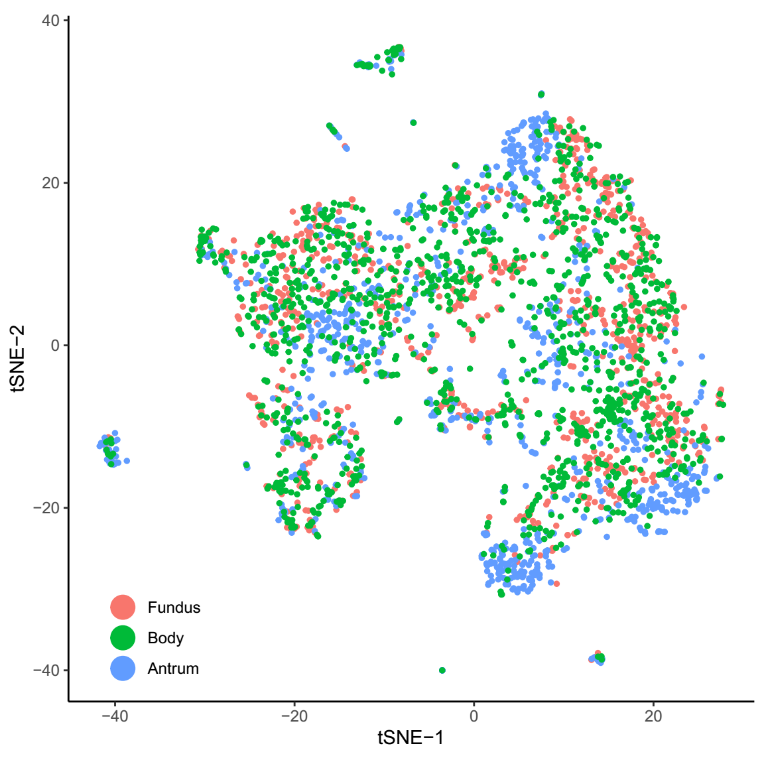
2. Stomach (14w)
58278 genes * 4032 cells -> 26555 genes * 3146 cells.

Slide 4
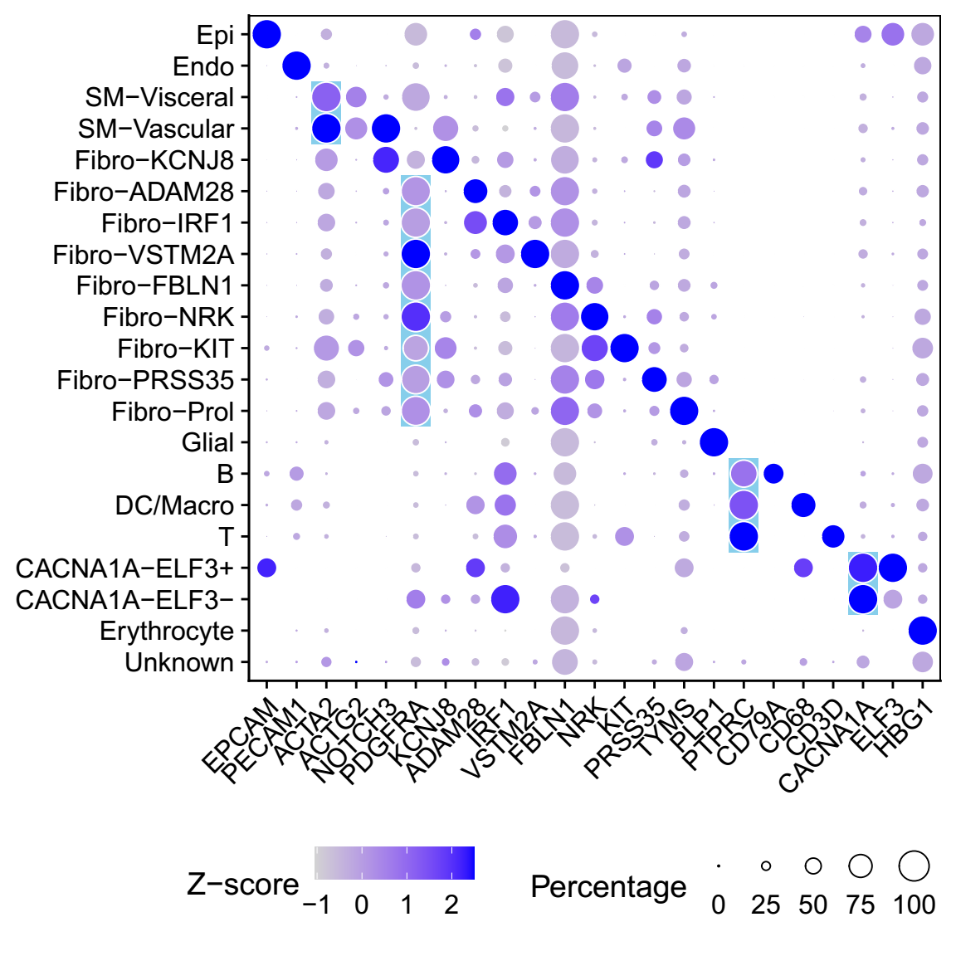
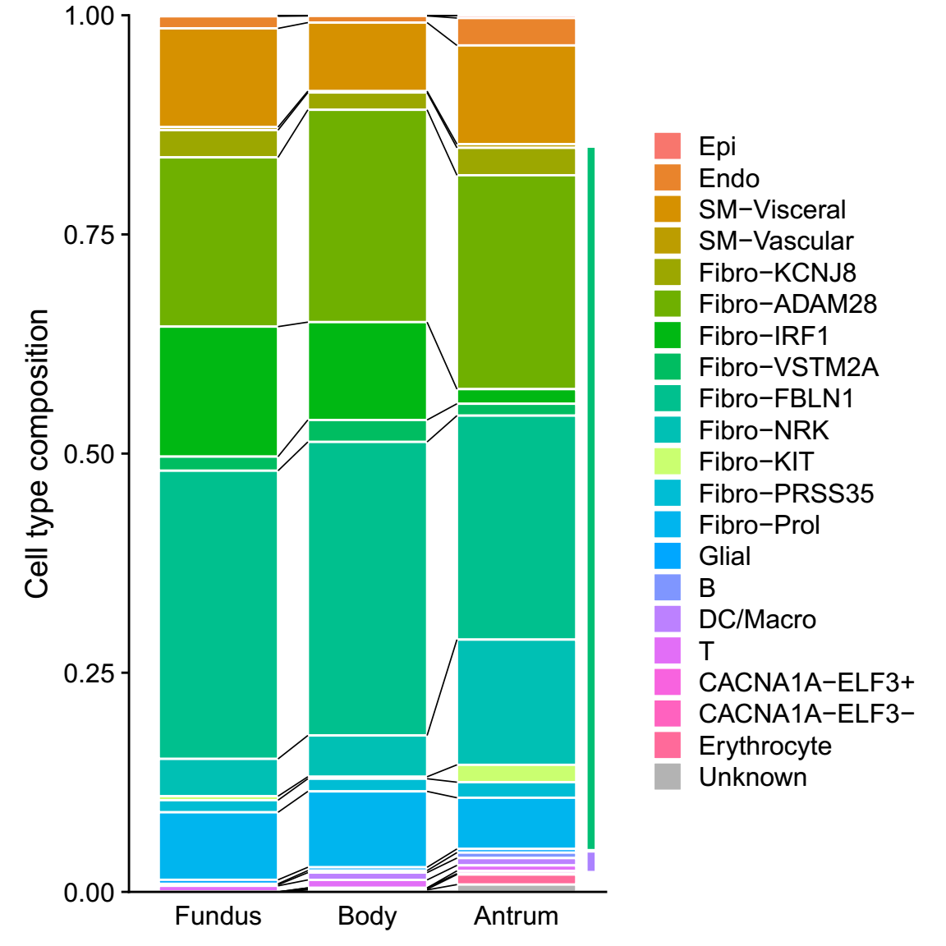
2. Stomach (14w)
58278 genes * 4032 cells -> 26555 genes * 3146 cells.

Slide 5
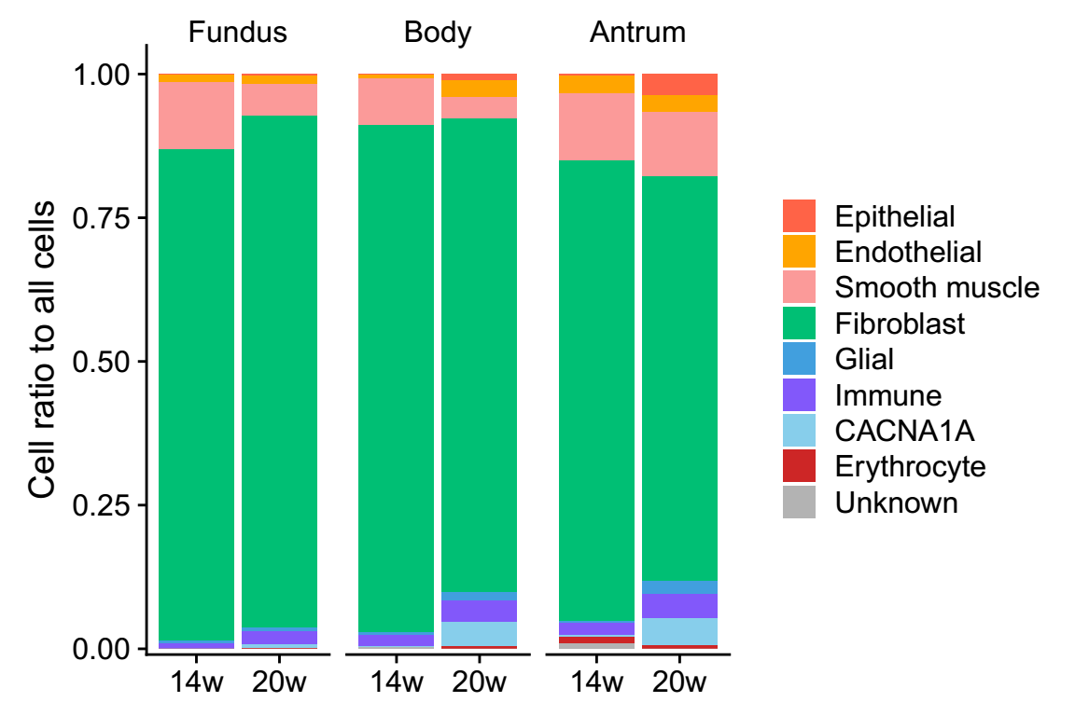
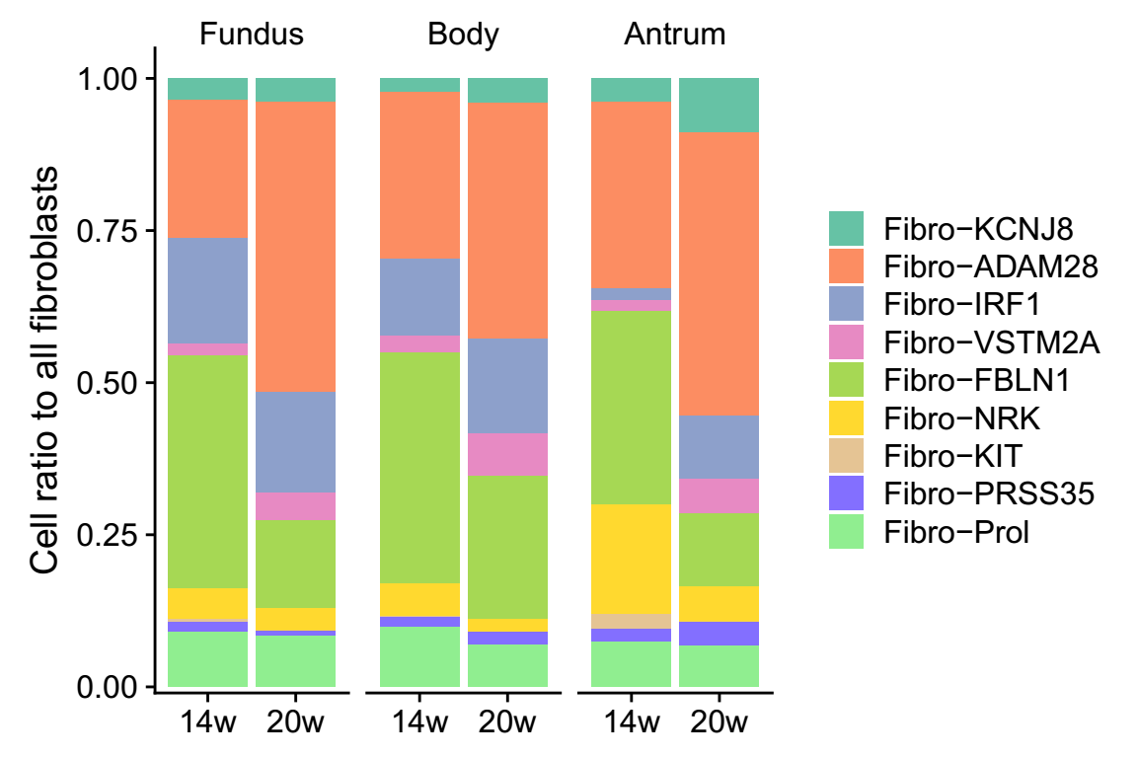
2. Stomach (14w ~ 20w)
The burst of epithelial cells and immune cells in 20-week-old.
The shift of cell type composition in fibroblasts.
Immunostaining?
14w
20w
EPCAM
PTPRC
DAPI
ADAM28
FBLN1

Slide 6
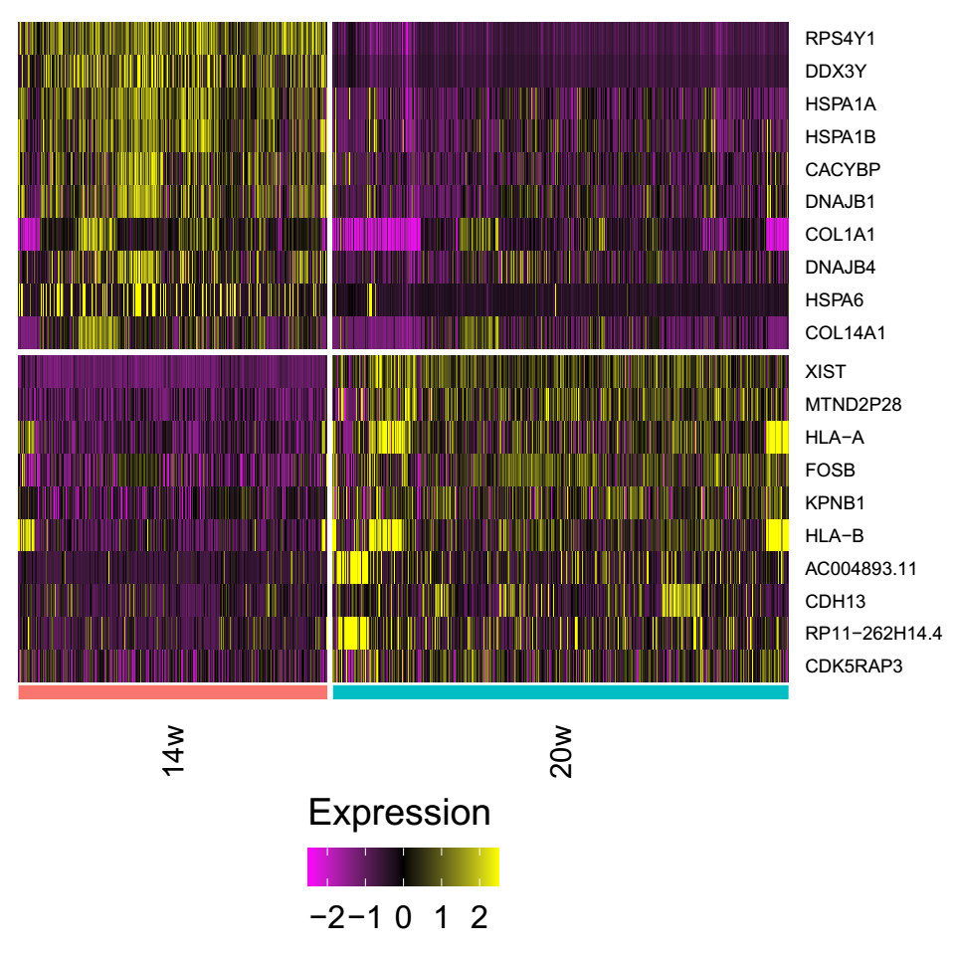
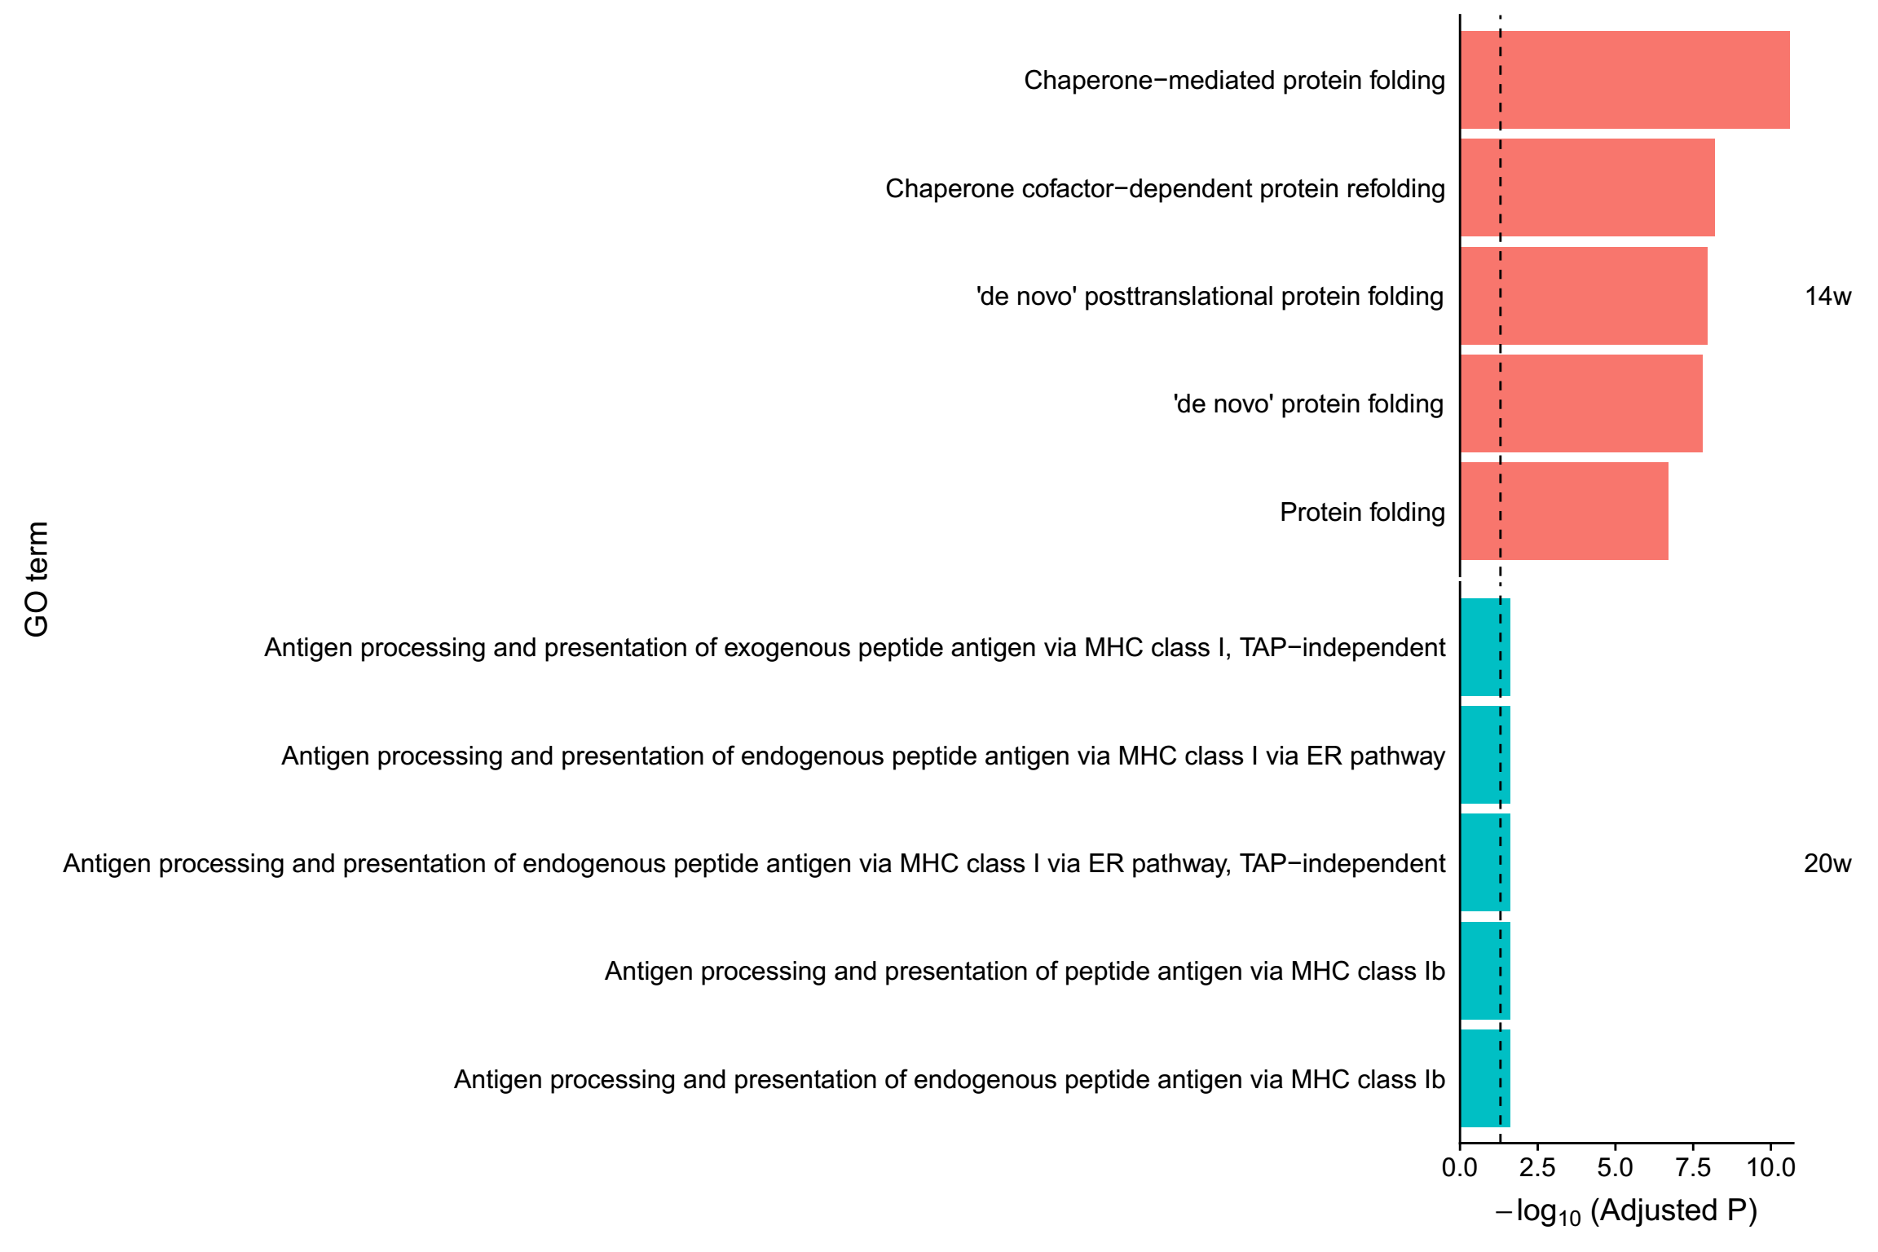
2. Stomach (14w ~ 20w)
Differentially expressed genes

Slide 7
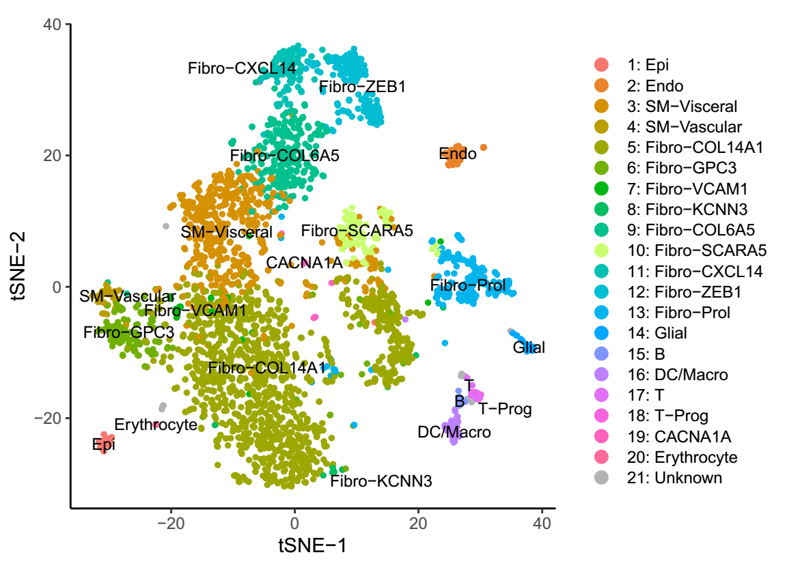
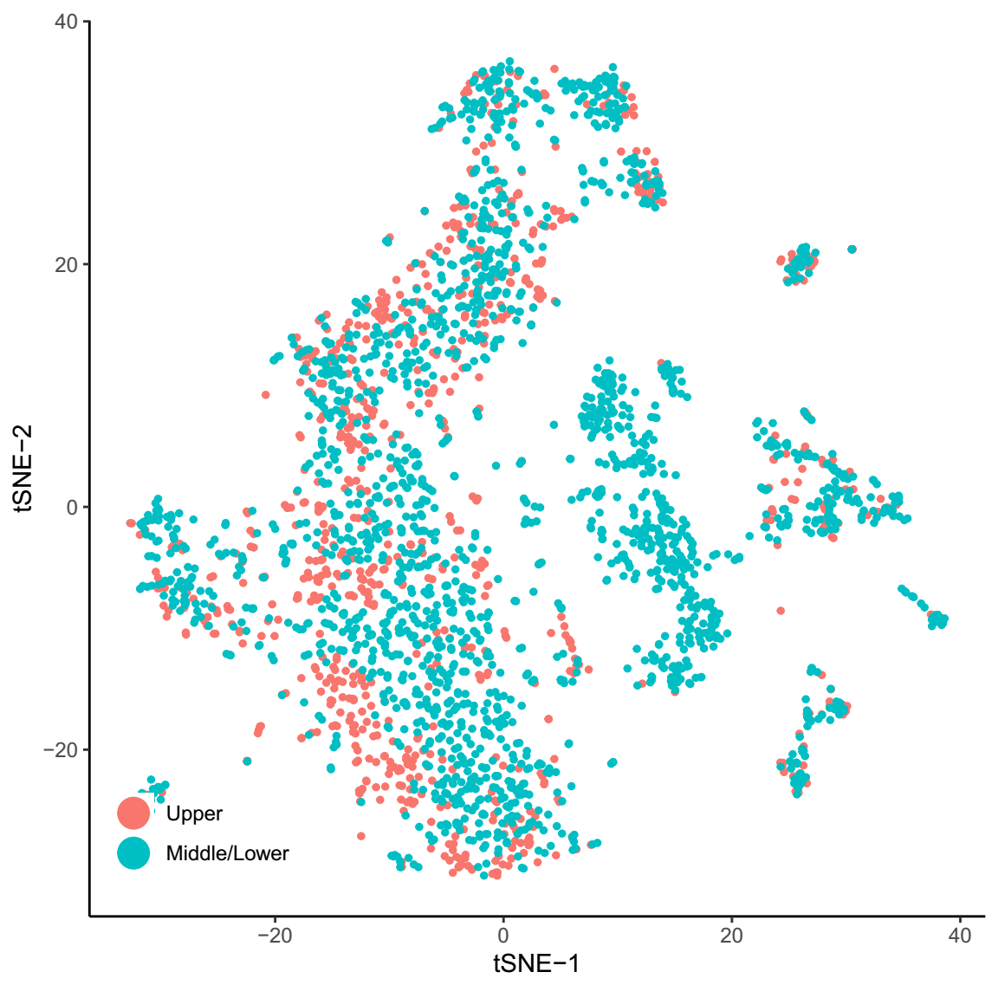
3. Small intestine (14w)
58278 genes * 4608 cells -> 27427 genes * 2915 cells

Slide 8
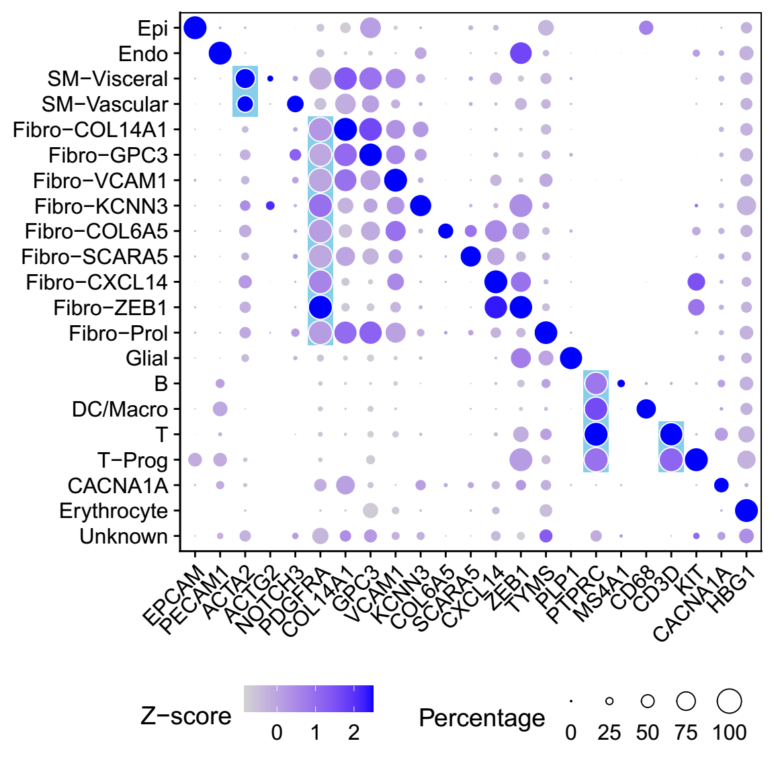
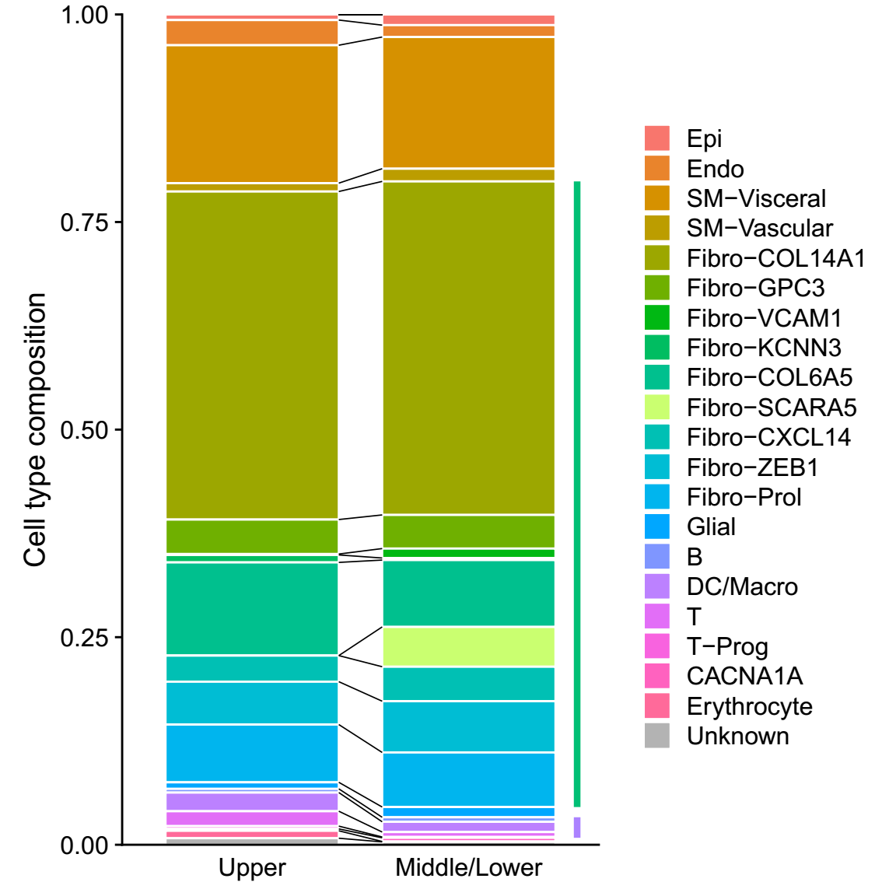
3. Small intestine (14w)
58278 genes * 4608 cells -> 27427 genes * 2915 cells

Slide 9
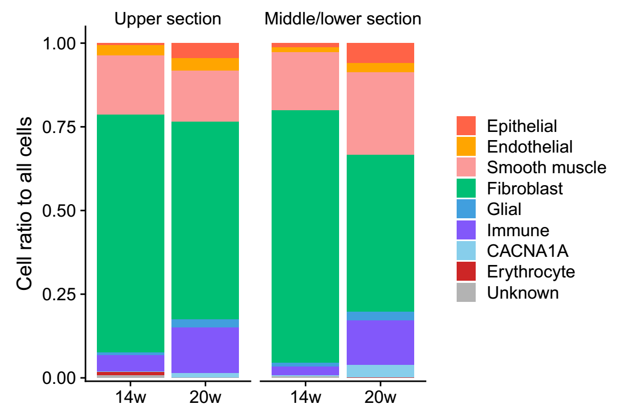
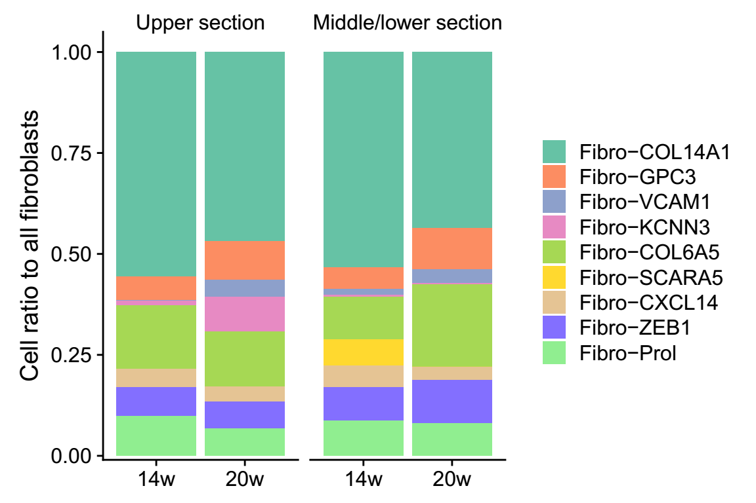
3. Small intestine (14w ~ 20w)
The burst of epithelial cells and immune cells in 20-week-old.
The shift of cell type composition in fibroblasts.
Immunostaining?
14w
20w
EPCAM
PTPRC
DAPI

Slide 10
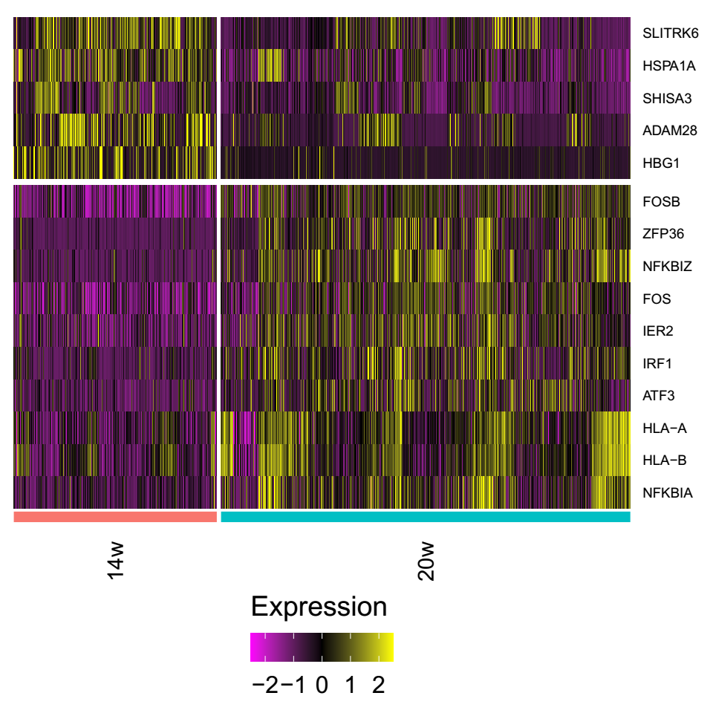
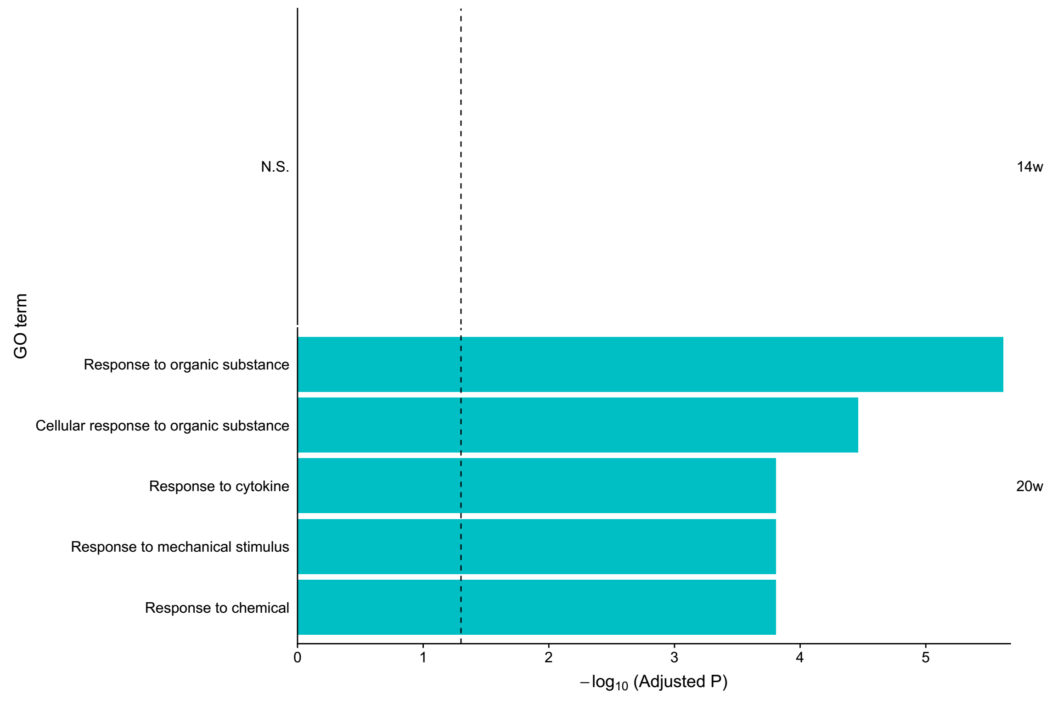
3. Small intestine (14w ~ 20w)
Differentially expressed genes

Slide 11
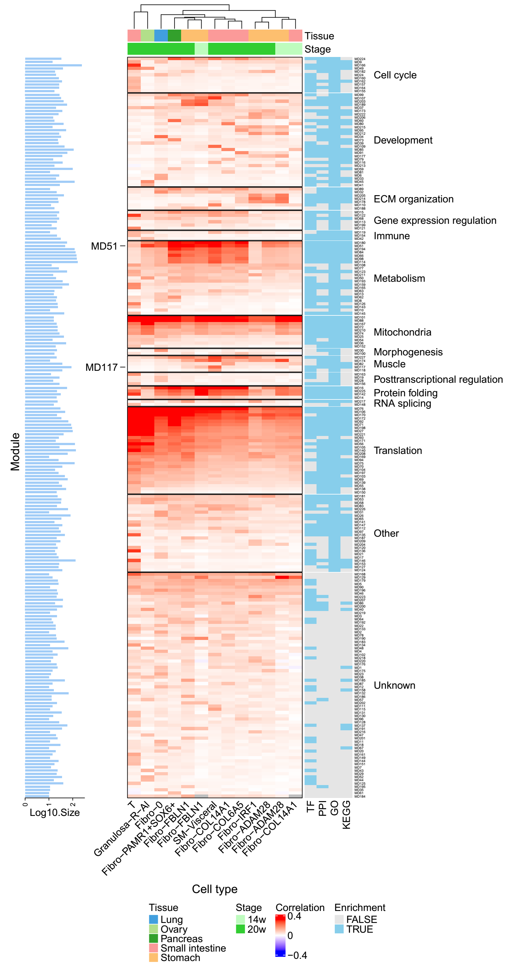
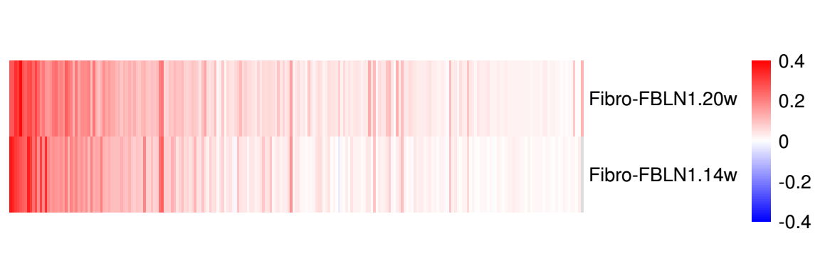
4. The gene module map
Three cell types in 14-week-old were added.

Slide 12
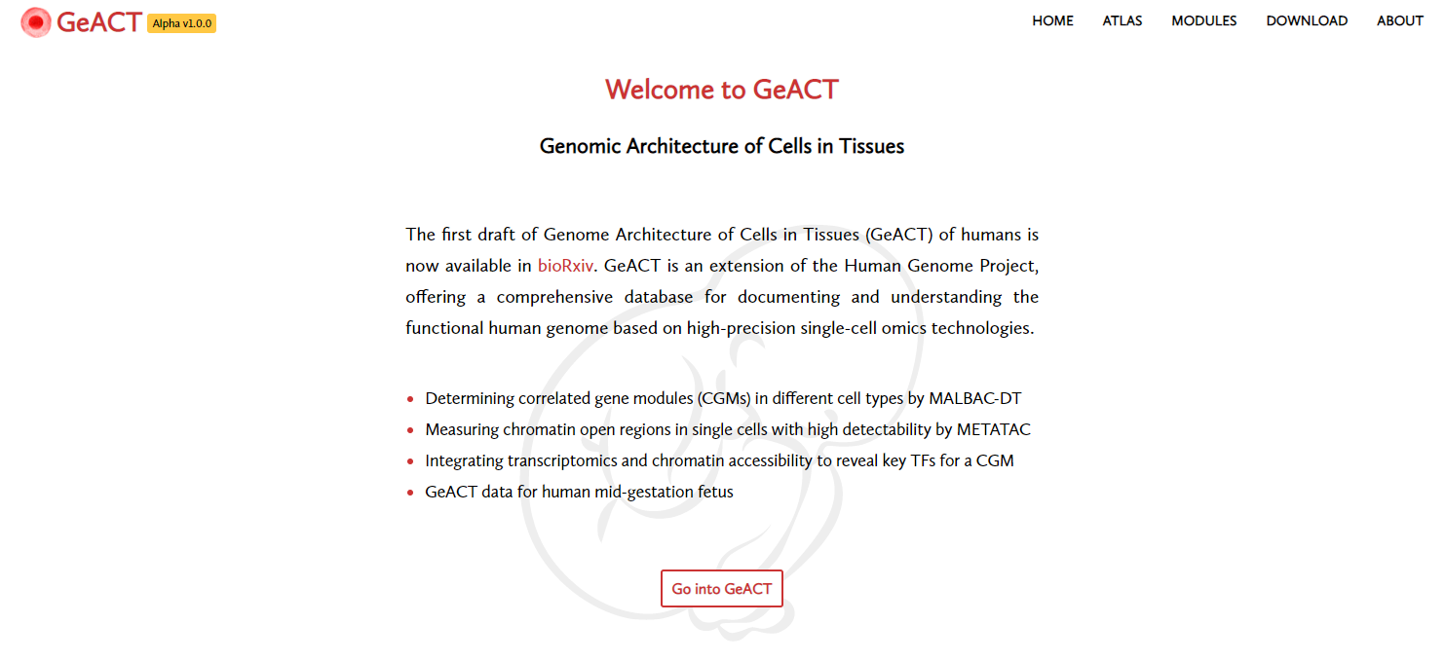
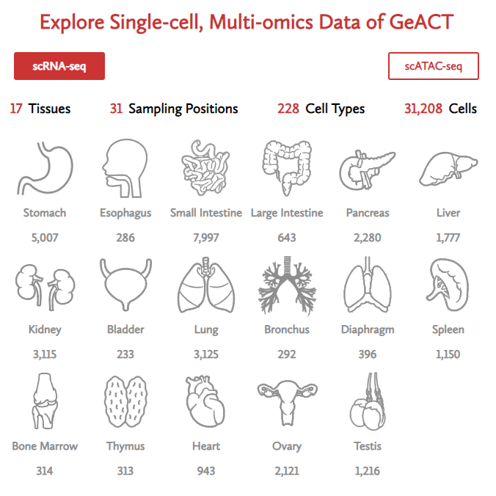
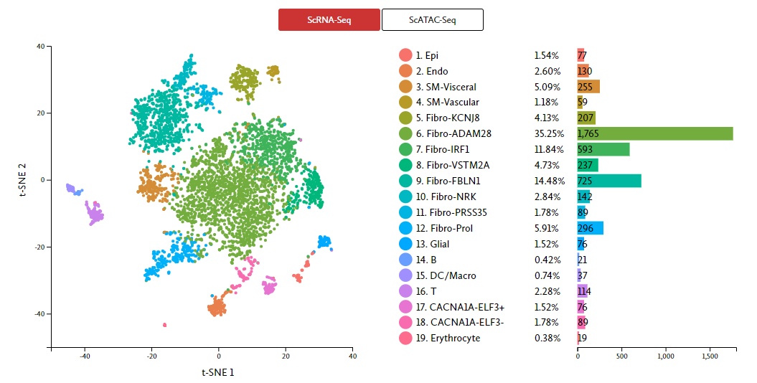
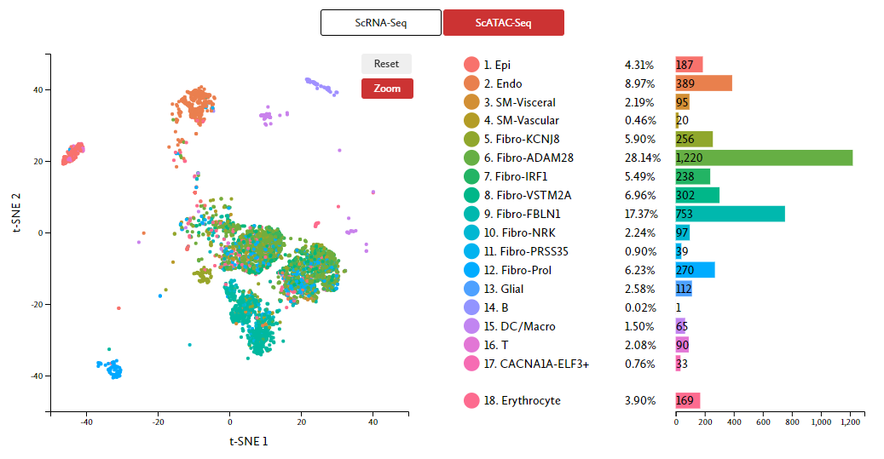
5. Website (design for update)
tSNE
10-14w
19-21w
tSNE
10-14w
19-21w
UMAP
UMAP
http://geact.gao-lab.org/
Website set up by Shen Lu and Dechang Yang

Slide 13
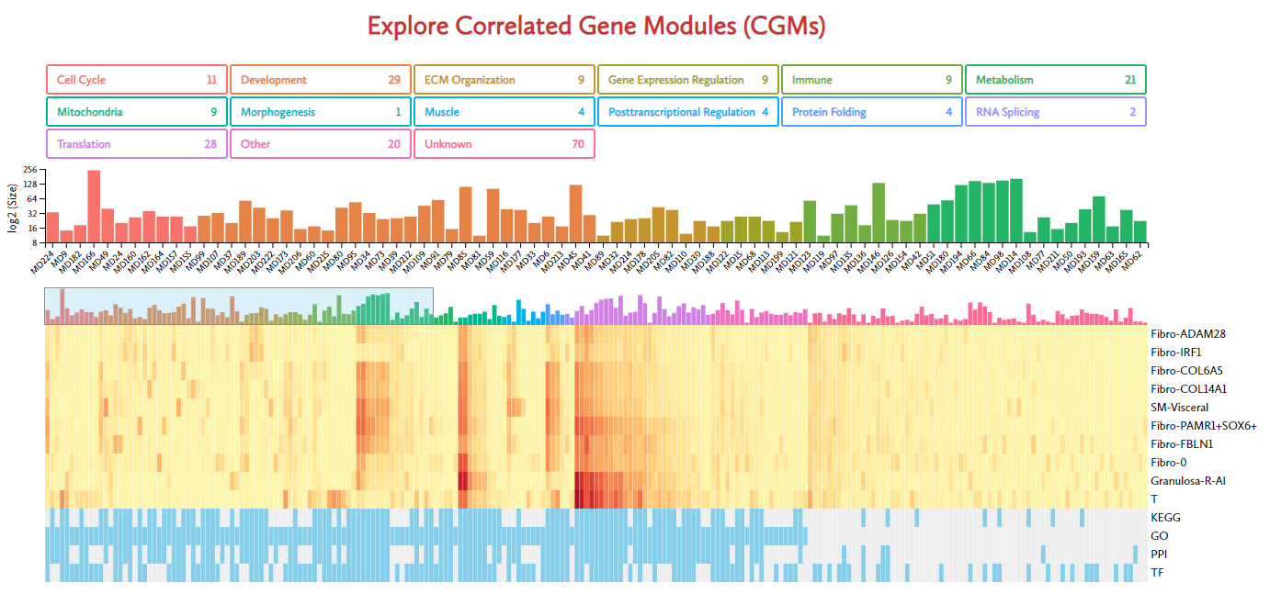

5. Website (design for update)
gene module table
Website set up by Shen Lu and Dechang Yang

Slide 14
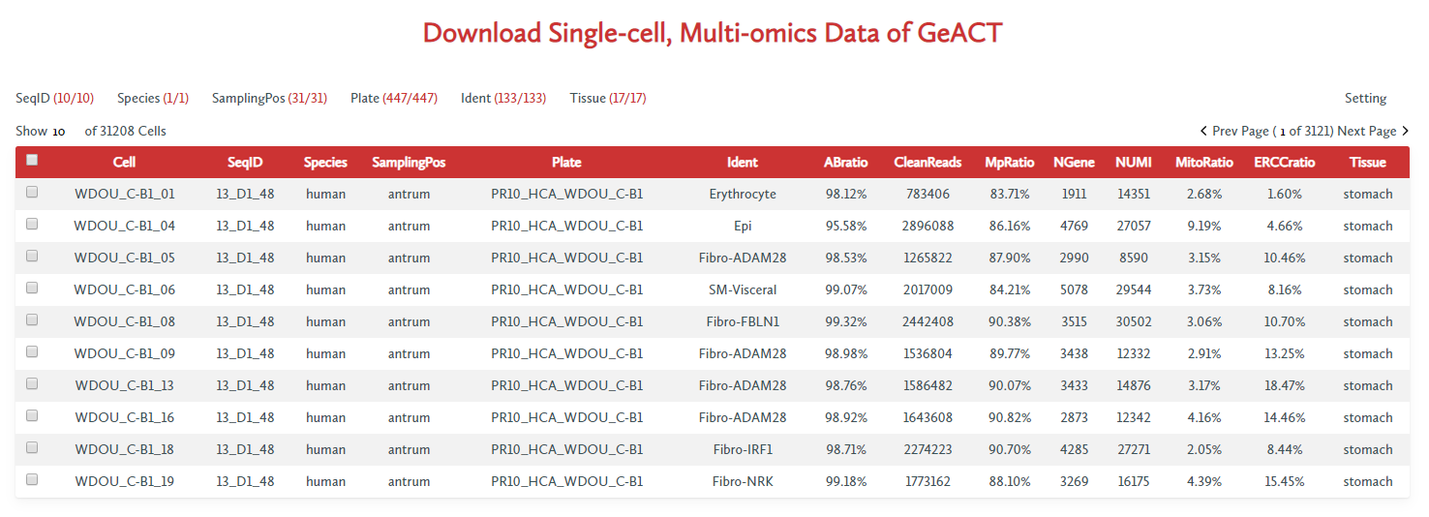
5. Website (design for update)
Stage
RNA
ATAC
Before downloading, please request for data in the Genome Sequence Archive (https://bigd.big.ac.cn/gsa-human) with the ID of HRA000330.
matrix
meta table
Website set up by Shen Lu and Dechang Yang

Slide 15
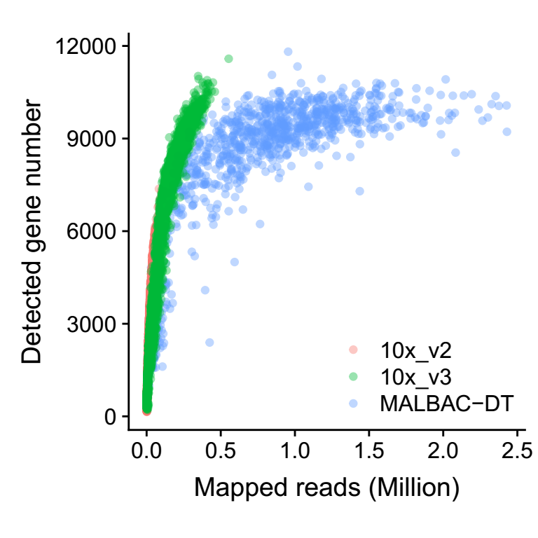
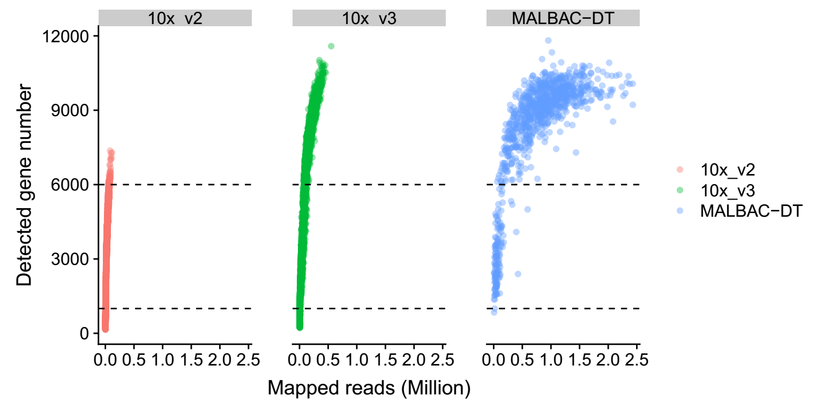
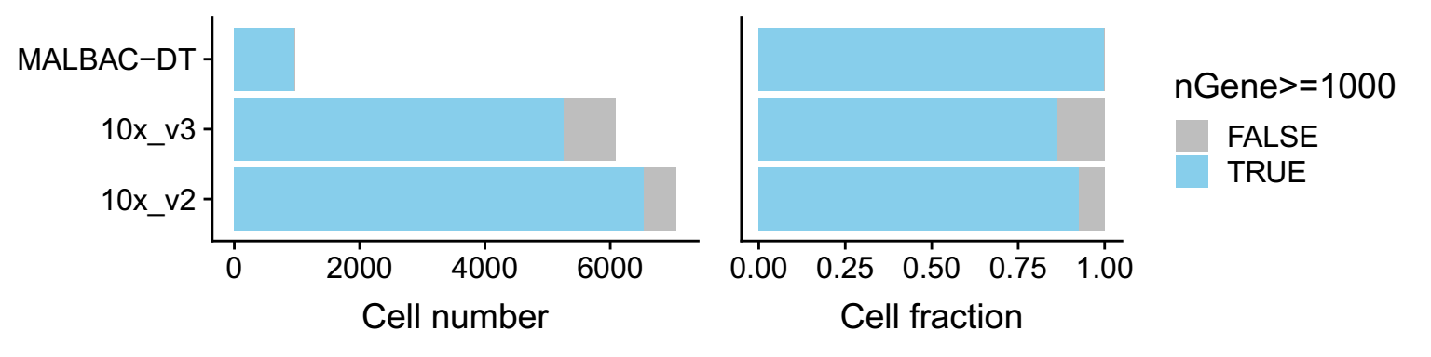
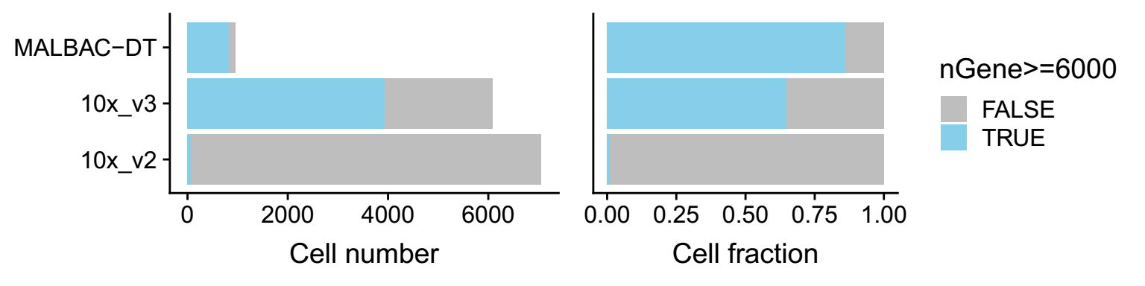
6. scRNA-seq method estimation

Slide 16
Thanks

